Slide 1
The Separation of Church and State vermont functional user group november 13, 2012
@eric_s_smith
github.com/ericssmith
http://whatisfp.net

Slide 2
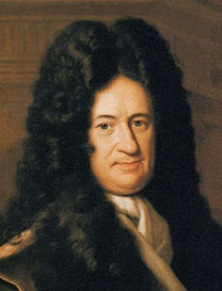
Gottfried Leibniz
Met Christian Huygens in Paris, 1672

Slide 3
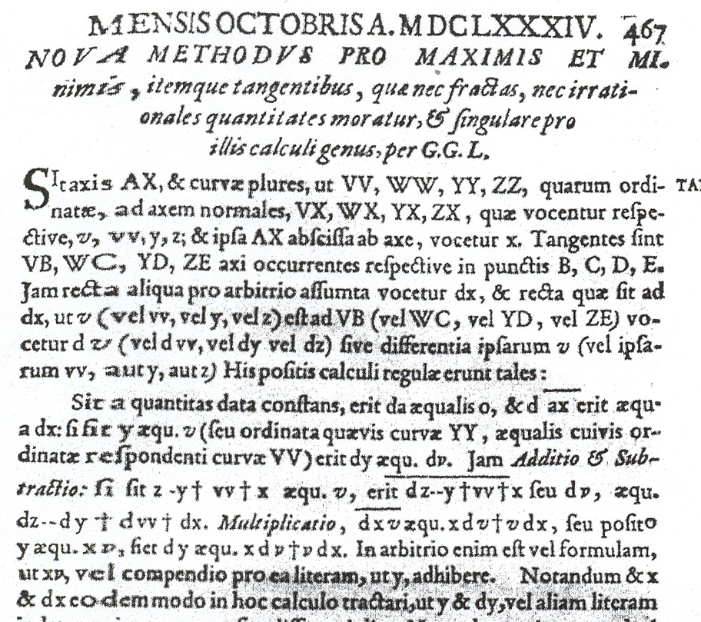
Leibniz ‘Acta Eruditorum’ – First publication of methods of the infinitesimal calculus in 1684.

Slide 4
Leibniz notation
“The derivative of y with respect to x”
“The indefinite integral of f(x) with respect to x”
But what are these?

Slide 5
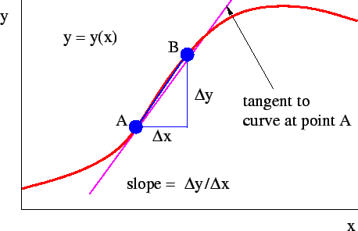
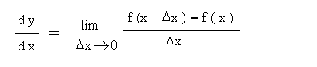

Slide 6
Differential Eqn – Separating variables
Acceleration of marble in certain fluid given by a = -3.00v². If initial velocity on entering is 1.5m/s, how long before velocity is halved?

Slide 7
Ghosts of Departed Quantities
“Now as our Sense is strained and puzzled with the perception of Objects extremely minute, even so the Imagination … is very much strained and puzzled to frame clear Ideas of the least Particles of time…at first fleeting and minute, soon vanishing out of sight”
George Berkeley (1734) ‘The Analyst -- A DISCOURSE Addressed to an Infidel MATHEMATICIAN. WHEREIN It is examined whether the Object, Principles, and Inferences of the modern Analysis are more distinctly conceived, or more evidently deduced, than Religious Mysteries and Points of Faith’

Slide 8
Utility vs foundation
“… a schism appeared between the theory and the practice of the calculus as the level of rigour in the calculus was raised: the foundationalists had one set of rules, the practitioners another. The situation has persisted to this day, with quite unfortunate and unnecessary confusions for students. It is a common experience for them to learn … that infinitesimally small differentials do not exist, but to use them constantly in the mathematical physics lectures. “
Ian Grattan-Guiness - “From the Calculus to Set Theory 1630-1920”

Slide 9
Indeed ….
“… take an infinitesimal distance and the corresponding infinitesimal time, form the ratio, and watch what happens to that ratio as the time that we use gets smaller and smaller and smaller. “
Richard Feymann describing velocity as a derivative in 1963 – ‘Lectures on Physics’ Vol I (8-4)

Slide 10
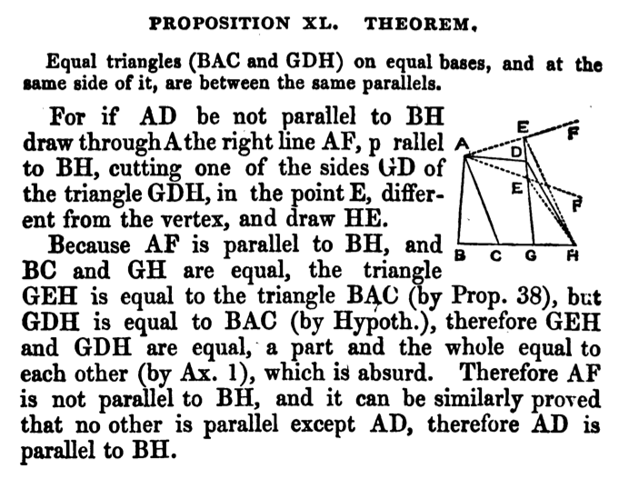
Euclid ‘Elements’ – Build complex propositions starting from small set of assertions and methods of proof.

Slide 11
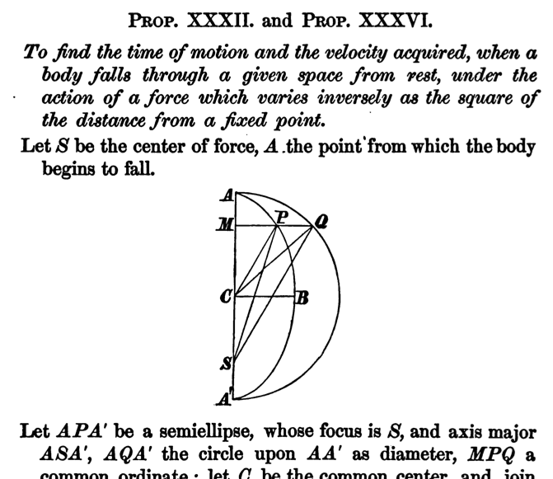
Newton “Principia” – Relied on geometry in 1687 to be convincing.

Slide 12
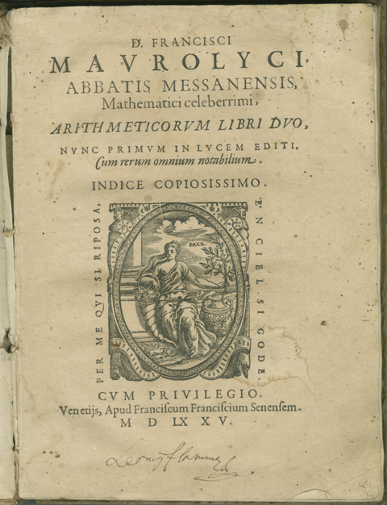
Francesco Maurolico - Arithmeticorum libri duo (1575)
Used induction to prove that first n odd integers is n²

Slide 13
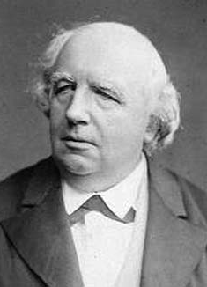
Karl Weierstrass – Univ. of Berlin 1857-1890
After 200 years, calculus finally had a solid foundation.

Slide 14
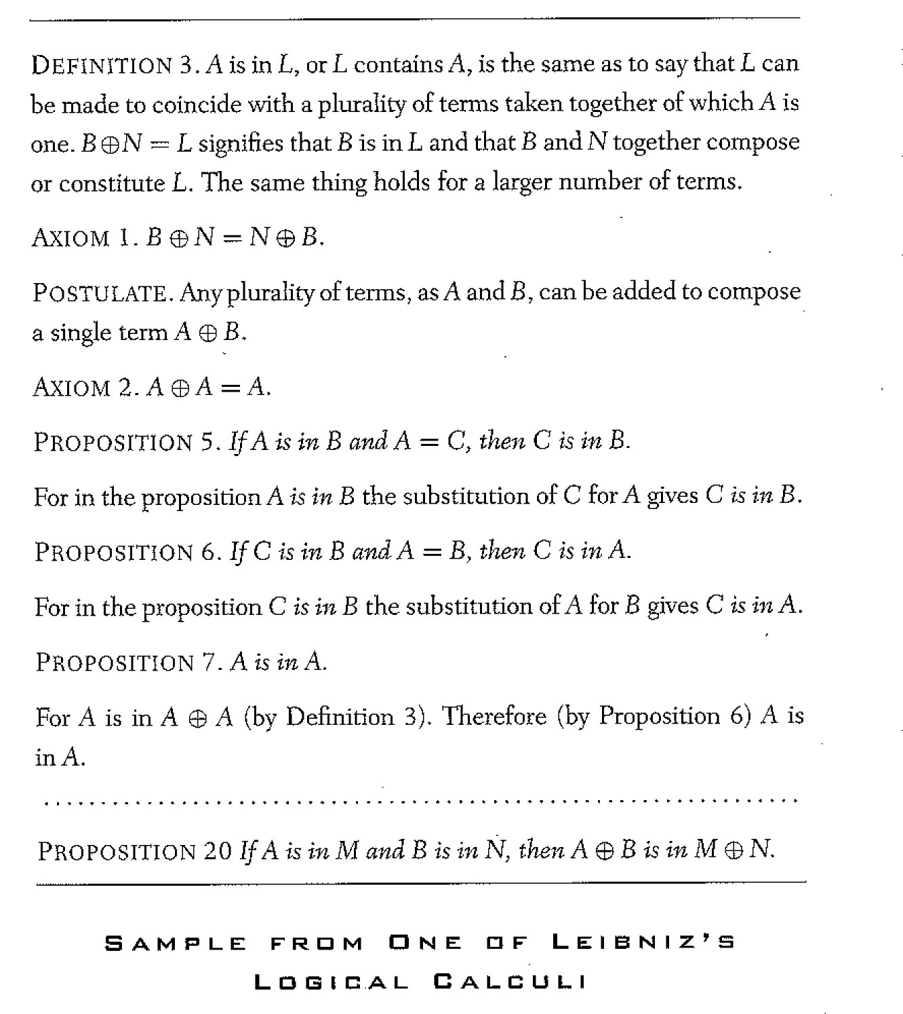
Calculus of Reason

Slide 15
Calculemus
“There is delivered a certain new and wonderful calculation, which has relation to all our reflections and which is proceeded not less accurate than Arithmetic and Algebra. As applied to controversions, they can terminate always as they are soluble on data just by putting pen to paper; it is sufficient for two disputers omitting verbal pleadings to say to each other: let us calculate”
Leibniz - INITIA ET SPECIMINA SCIENTIAE NOVAE GENERALIS
http://www.uni-muenster.de/Leibniz/DatenVI4/VI4a1.pdf (p443). See also http://mathforum.org/kb/message.jspa?messageID=1176948
Reasoning can be represented as calculations. Disputes could be resolved by calculating.

Slide 16
Leibniz’s Dream
“Leibniz’s dream … with the words “Let us calculate,” those knowing the rules of logic would be able to proceed to determine unfailingly whether or not some conclusion follows”
Martin Davis* – Engines of Logic (p54)
* Davis was one of the people who resolved Hilbert’s Tenth problem in the negative.

Slide 17
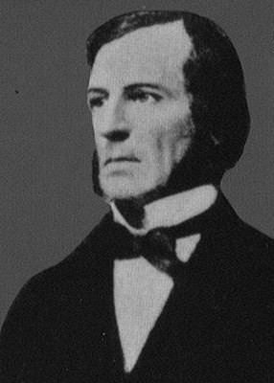
George Boole

Slide 18
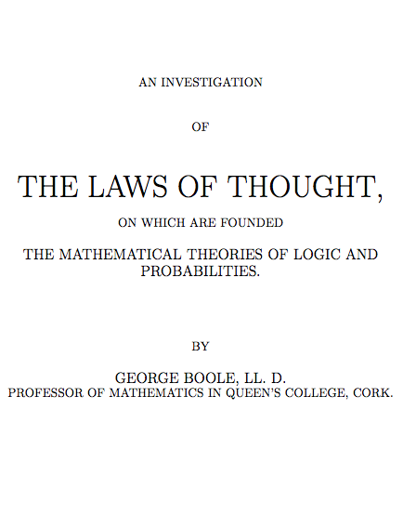
Published 1854. Preceded in 1847 by Mathematical Analysis of Logic

Slide 19
Algebra of logic
“If x stands for ‘white things’ and y stands for ‘sheep’, let xy stand for ‘white sheep.”
What if you have yy? When is yy = y true in ordinary algebra? When y is 0 or 1
x is men, y is women; x+y is all men and women
x is all people, y is children; x – y is adults
1 – x is class of things not in x
‘all x are y’ is x(1 - y) = 0; same as x = xy
There is nothing in x that does not belong to y

Slide 20
Algebra of logic
All horses are mammals X = XY
All mammals are vertebrates Y = YZ
---------------------------------
All horses are vertebrates X = XZ
X = XY = X(YZ) = XYZ = (XY)Z = XZ

Slide 21
Algebra of logic
x = 1 means its true; x = 0 is false
xy = 1 is same as ‘AND’, ie, true when both are true
‘If x, then y’ is x(1-y) = 0
Same expression as used for ‘all x are y’
Think of it as ‘if x=1 then y=1’
Substituting x=1 into x(1-y) = 0 gives 1-y = 0, which is 1 = y

Slide 22
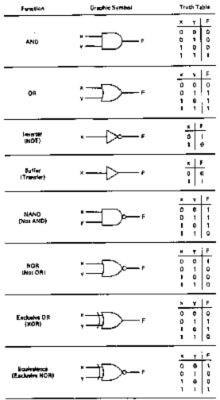
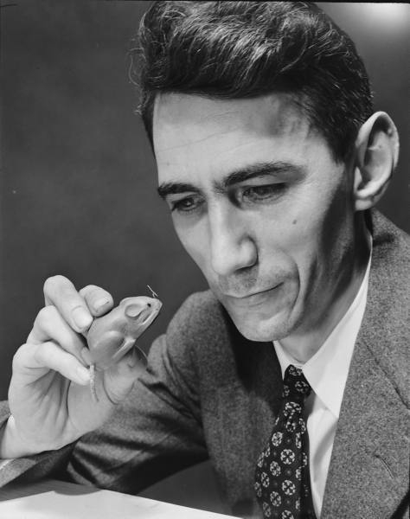
Claude Shannon applied Boolean algebra to switching relays in 1937.

Slide 23
What about …
“All failing students are either stupid or lazy”

Slide 24
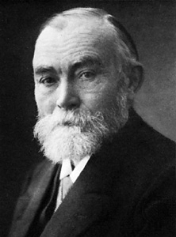
Gottlob Frege

Slide 25
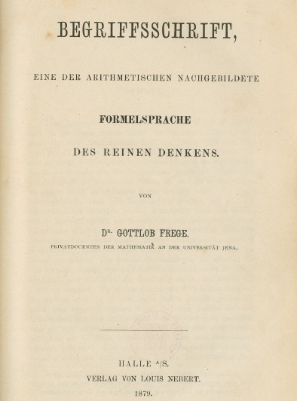
Frege “Begriffschrift” (1879) .

Slide 26
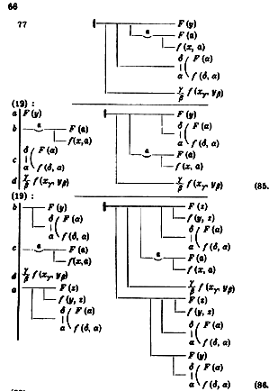
Begriffsschrift – idiosyncratic notation

Slide 27
Frege logic
Propositional function vs proposition
Proposition ‘John is a man’ contains only constants.
It is true or false
Propositional function ‘x is a man’ contains variables.
True for some variables, false for others.

Slide 28
Frege logic
Quantification of propositional functions
Domain of variables in which they’re true:
Universal quantifier – ‘For every x’
Existential quantifier – ‘For some x’

Slide 29
All horses are mammals
If x is a horse , then x is a mammal
(∀x)(if x is a horse, then x is a mammal)
(∀x) (x is a horse ⊃ x is a mammal)
(∀x)(horse(x) ⊃ mammal(x))
(∀x)(h(x) ⊃ m(x))
Some horses are pure-bred
x is a horse and x is pure-bred
(∃x) (x is a horse and x is pure-bred)
(∃x) (x is a horse ∧ x is pure-bred)
(∃x) (horse(x) ∧ pure-bred(x))
(∃x) (h(x) ∧ p(x))

Slide 30
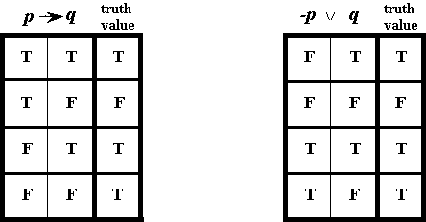
Frege logic
Material implication
Replace conditional with disjunction when antecedent is negated

Slide 31
“All failing students are either stupid or lazy”

Slide 32
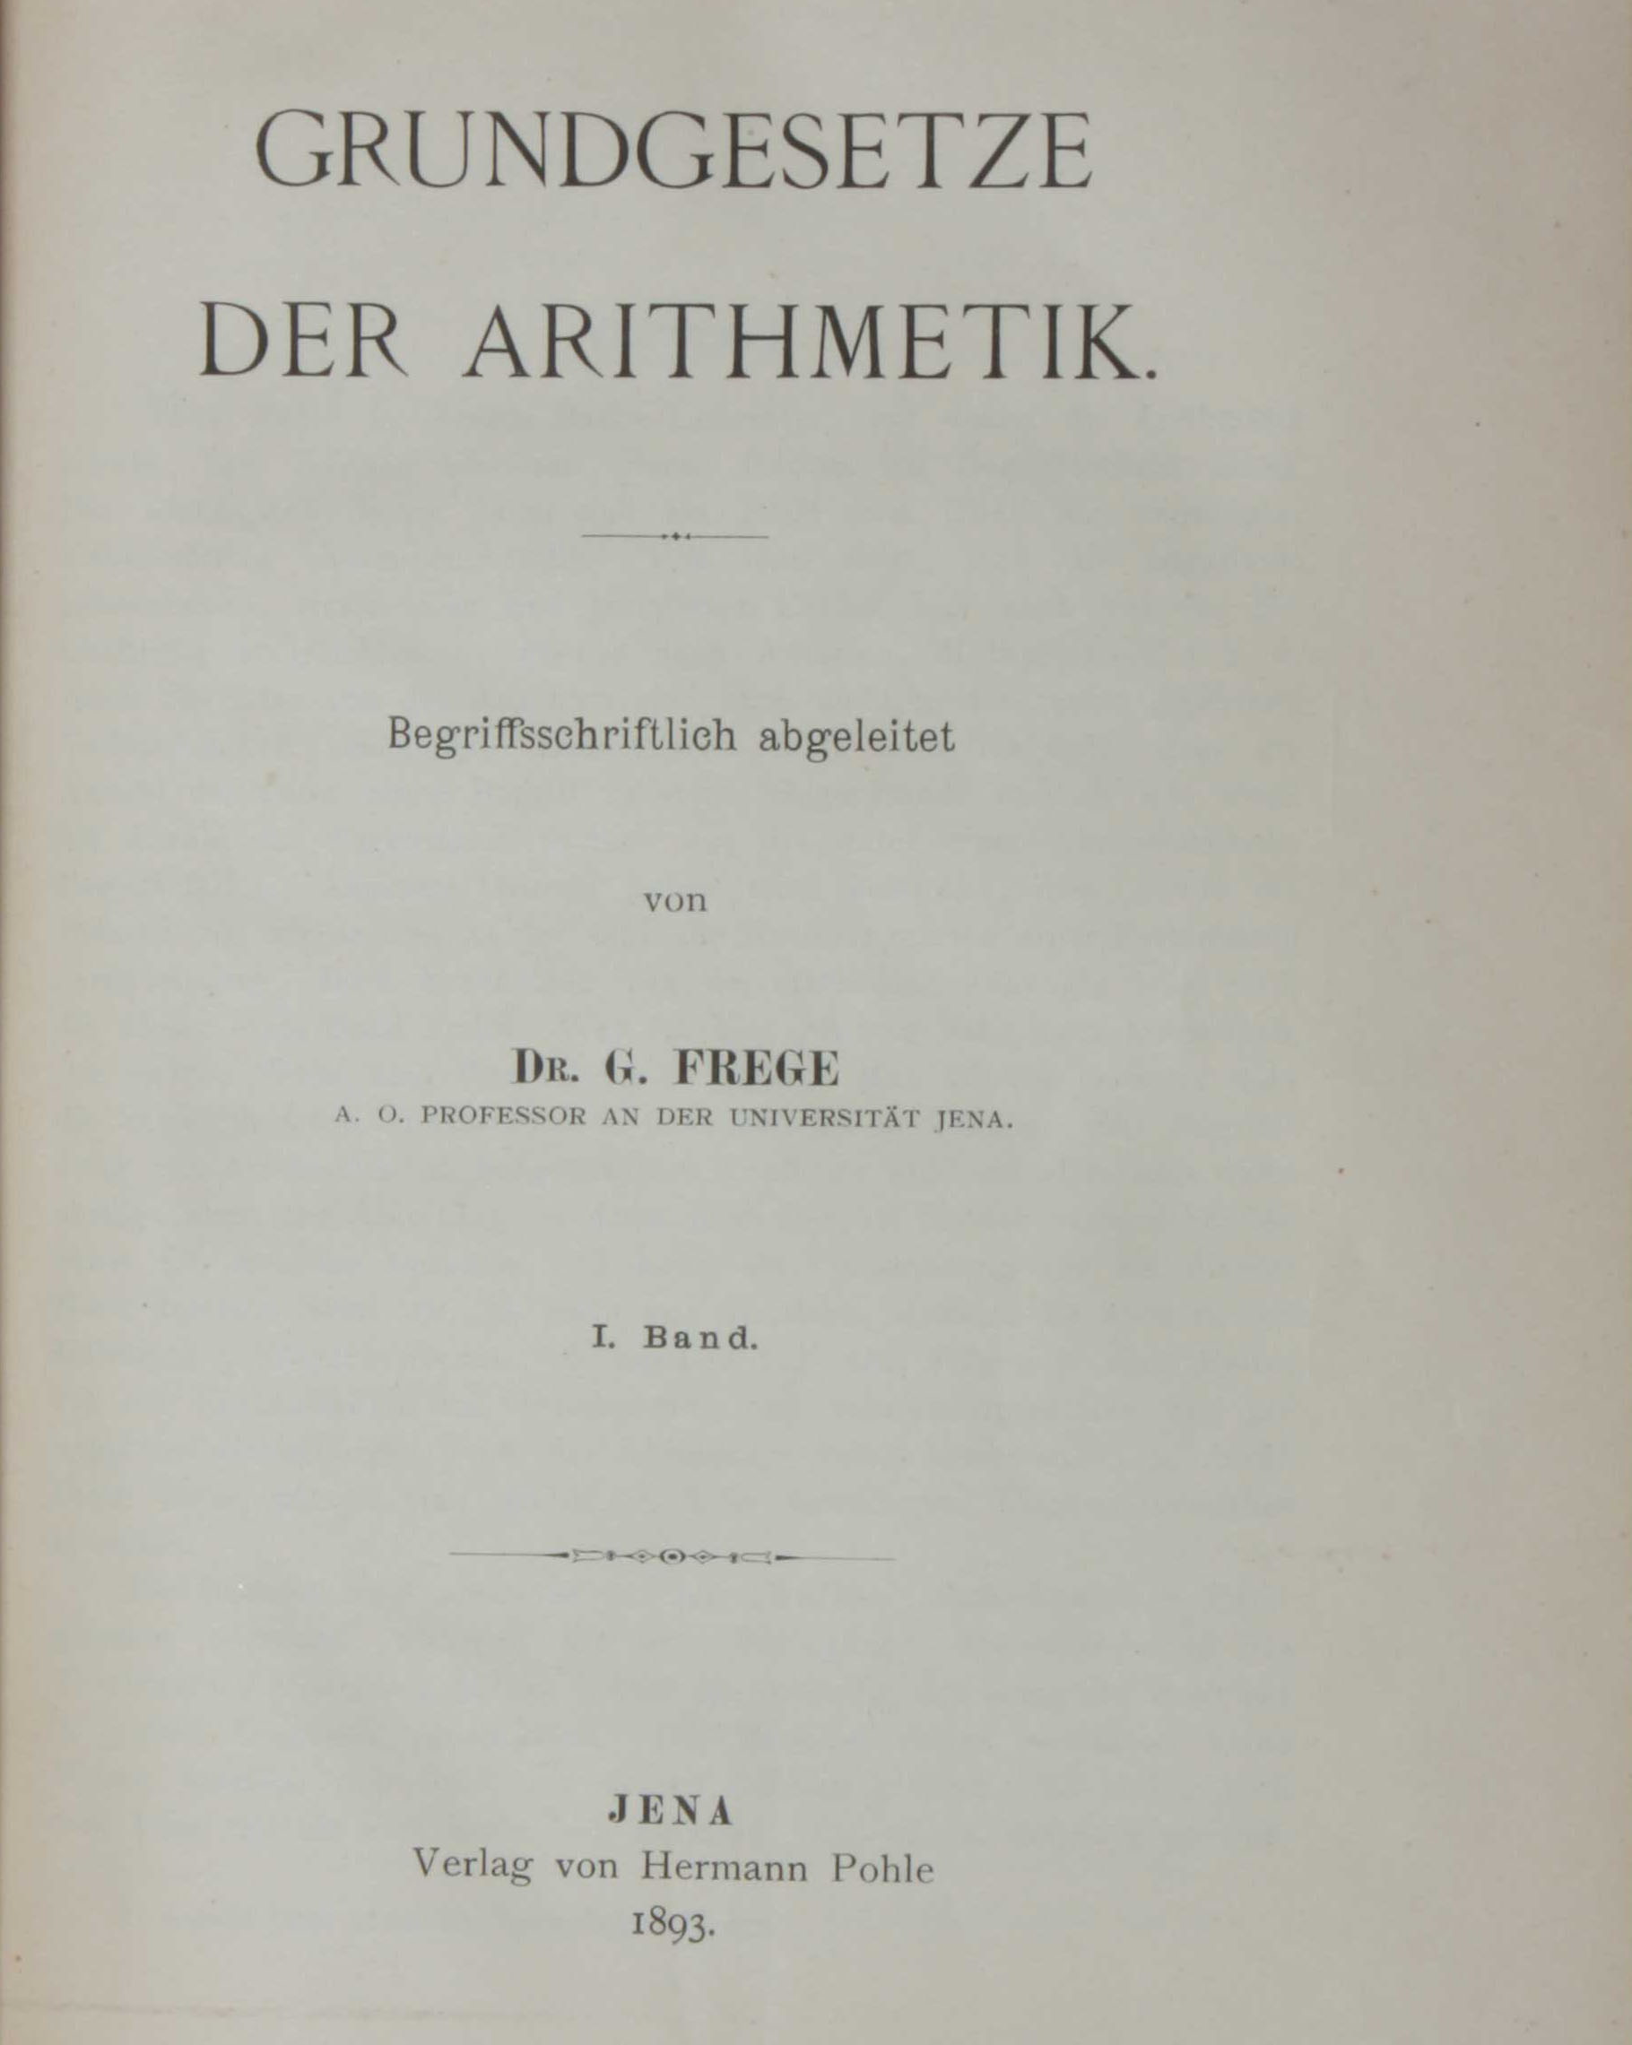
Grundlagen der Arithematik (1884), Grundsetze der Arithematik (1893, 1903)

Slide 33
What is a number?
“Frege’s idea was to define number of elements in a set to be the set of all sets that can be matched up one-to-one with the given set. The number 3 is identified with the set of all sets of ‘triples’: points on a triangle, Holy Trinity, leaves on a clover, the set of letters {a, b, c}.”
Martin Davis – Engines of Logic p55 (paraphrased)

Slide 34
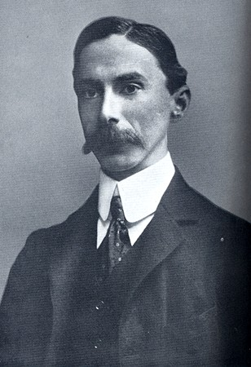
Bertrand Russell

Slide 35
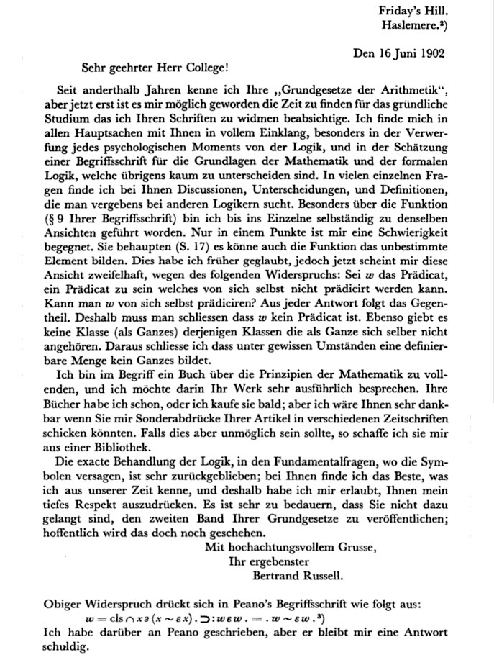

Slide 36
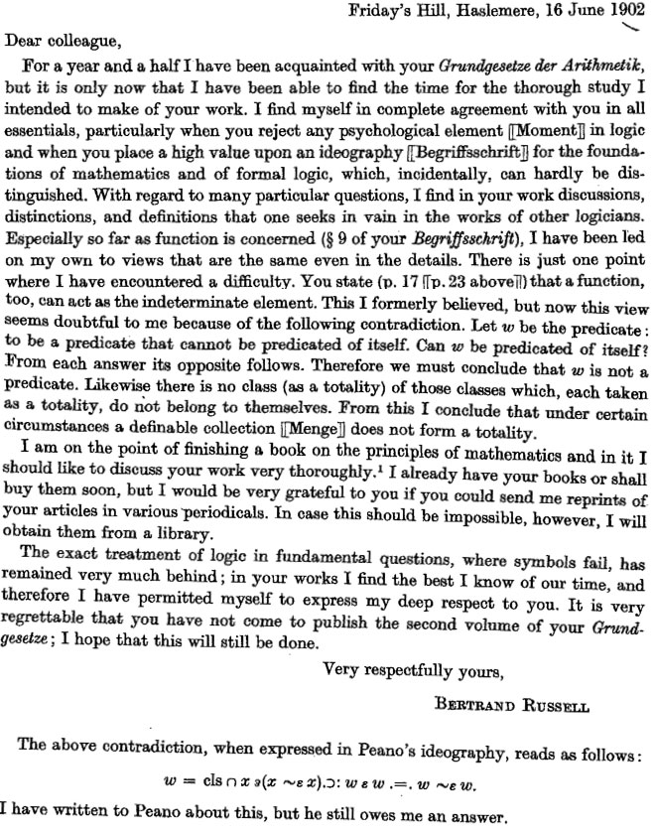

Slide 37
The flavor of Russell’s paradox
x is the collection of integers, represented by n, that are greater than 3 and less than 7
x = { n: n is an integer and 3 < n < 7}
Scientific American – ‘What is Russell’s Paradox?’ Aug 17, 1998

Slide 38
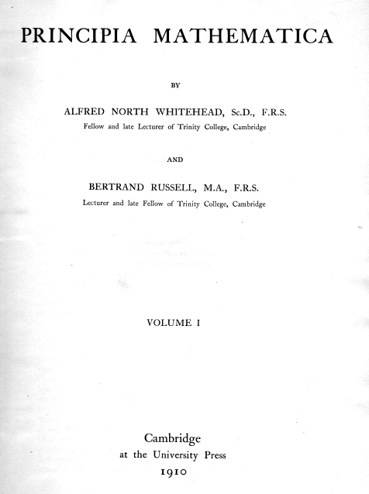

Slide 39
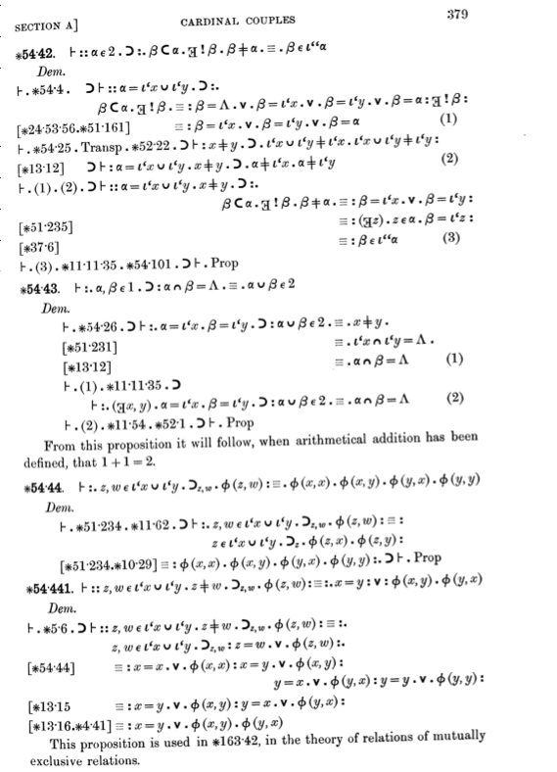

Slide 40
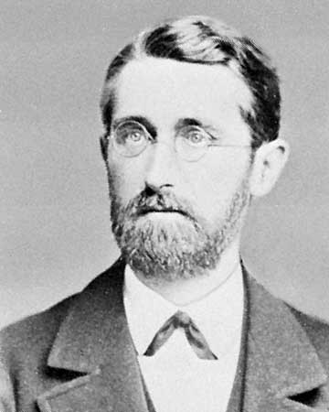
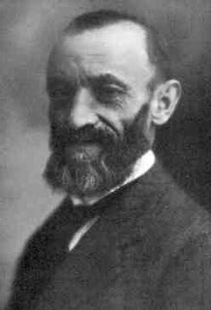
Richard Dedekind
‘Was sind und was sollen die Zahlen’ 1888
Giuseppe Peano
‘Arithmetices principia, nova methodo exposita’ 1889

Slide 41
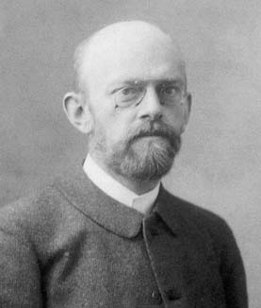
David Hilbert

Slide 42
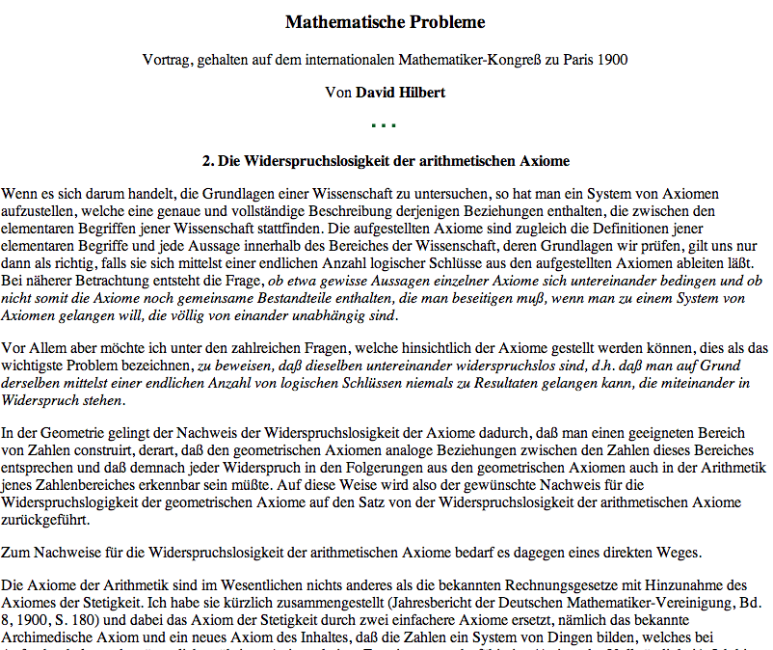
The second of 23 problems – The compatability of the arithemetical axioms
http://aleph0.clarku.edu/~djoyce/hilbert/problems.html

Slide 43
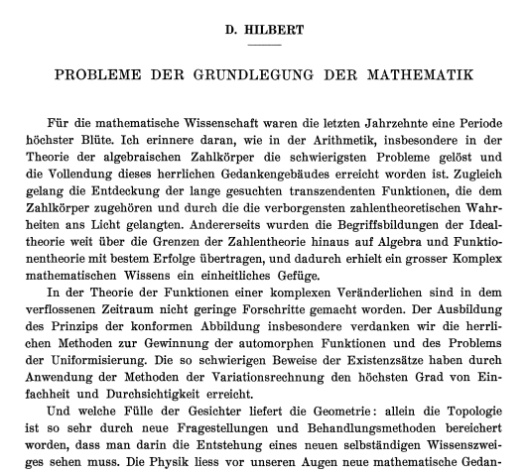
Address to the 1928 International Congress of Mathematicians - Bologna

Slide 44
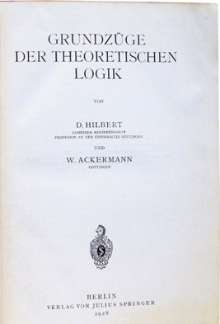

Slide 45
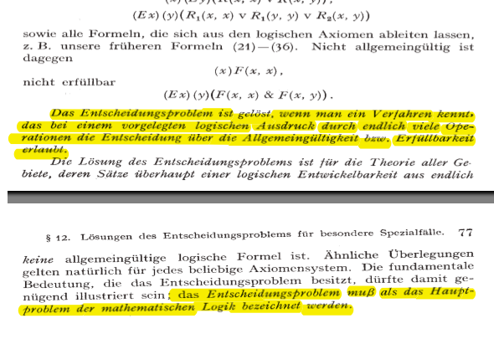
"The decision problem is solved when we know a procedure that allows one to decide by finitely many operations the validity or satisfiability of any given logical expression .… The decision problem must be considered the main problem of mathematical logic.”

Slide 46
Entscheidungsproblem (Decision problem)
“Provide a method that would , given a formula of first-order logic, determine in a finite number of steps whether or not that formula is valid”
Martin Davis – Engines of Logic

Slide 47
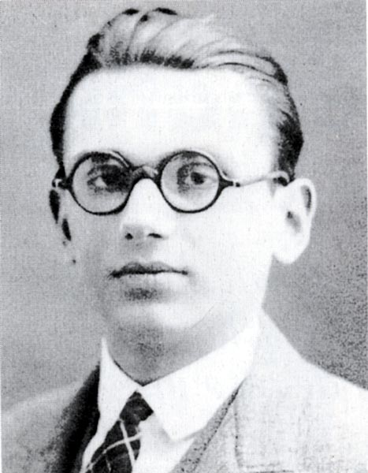

Kurt Gödel
John von Neumann
During a roundtable discussion on the third day of Conference on the Epistemology of the Exact Sciences (1930 annual meeting of Society of German Scientists) Gödel presented his result. Von Neumann later wrote to him “Since you have established the unprovability of consistency … I will not publish on that subject”.

Slide 48
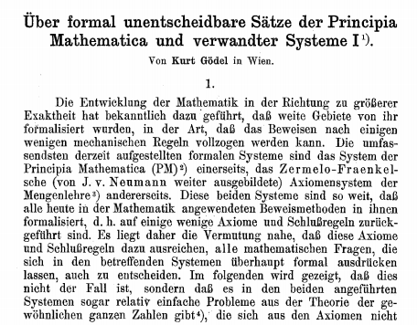
On Formally Undecidable Propositions of Principia Mathematica
and Related Systems – Nov 17, 1930

Slide 49
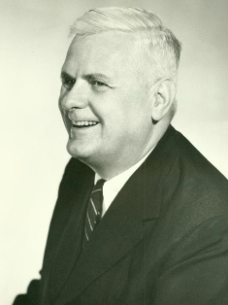
Alonzo Church

Slide 50
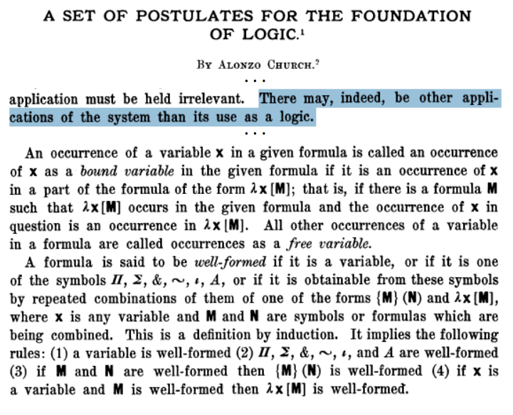

Slide 51
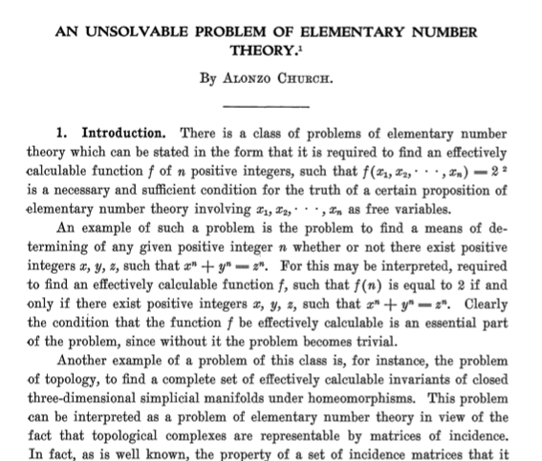
Church – 1932 created a formal system for representing functions as foundation for logic. In 1936, used to define ‘effectively calculable’

Slide 52
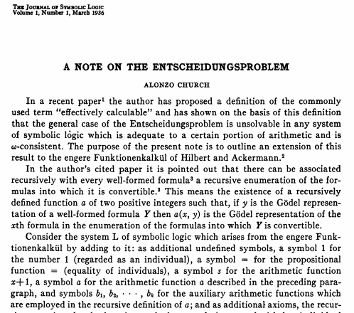

Slide 53
A term in this system can be ...
variable - x,y,z etc.
application - AB
abstraction - λx.A

Slide 54
Abstraction
10*8
10*9
10*11
10*x
f(x) = 10*x
Application
f(8) = 10*8
f(9) = 10*9
f(11) = 10*11

Slide 55
λx.x

Slide 56
λx.xλx.x

Slide 57
λx.xλx.x

Slide 58
λx.xλx.x
λx.x

Slide 59
Currying
λx.λy.y

Slide 60
Currying
λx.λy.xy

Slide 61
Abbreviation
λx.λy.xy => λxy.xy

Slide 62
α-equivalence
λx.x is the same as λa.a

Slide 63
λx.λy.xyλx.λy.yλx.λy.xλx.λy.y

Slide 64
λx.λy.xyλx.λy.yλx.λy.x(λx.λy.y)

Slide 65
λx.λy.xyλx.λy.y(λx.λy.x)(λx.λy.y)

Slide 66
λx.λy.xy(λx.λy.y)(λx.λy.x)(λx.λy.y)

Slide 67
(λx.λy.xy)(λx.λy.y)(λx.λy.x)(λx.λy.y)
Notes:
….

Slide 68
(λx.λy.xy)(λa.λb.b)(λe.λf.e)(λs.λt.t)

Slide 69
(λx.λy.xy)(λa.λb.b)(λe.λf.e)(λs.λt.t)

Slide 70
((λx.λy.xy)(λa.λb.b))(λe.λf.e)(λs.λt.t)

Slide 71
(((λx.λy.xy)(λa.λb.b))(λe.λf.e))(λs.λt.t)

Slide 72
(((λxy.xy)(λab.b))(λef.e))(λst.t)

Slide 73
(((λxy.xy)(λab.b))(λef.e))(λst.t)
AND
Notes:
.

Slide 74
(((λxy.xy)(λab.b))(λef.e))(λst.t)
AND True

Slide 75
(((λxy.xy)(λab.b))(λef.e))(λst.t)
AND True False

Slide 76
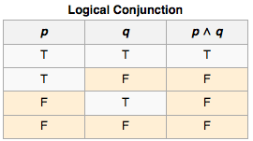
(((λxy.xy)(λab.b))(λef.e))(λst.t)
AND True False same as True ∧ False

Slide 77
(((λxy.xy)(λab.b))(λef.e))(λst.t)
AND True False same as True ∧ False

Slide 78
β- reduction
(((λxy.xy)(λab.b))(λef.e))(λst.t)

Slide 79
(((λxy.xy)(λab.b))(λef.e))(λst.t)

Slide 80
(((λxy.xy)(λab.b))(λef.e))(λst.t)
((λy.(λab.b)y)(λef.e))(λst.t)

Slide 81
(((λxy.xy)(λab.b))(λef.e))(λst.t)
((λy.(λab.b)y)(λef.e))(λst.t)

Slide 82
(((λxy.xy)(λab.b))(λef.e))(λst.t)
((λy.(λab.b)y)(λef.e))(λst.t)
((λab.b)λef.e)(λst.t)

Slide 83
(((λxy.xy)(λab.b))(λef.e))(λst.t)
((λy.(λab.b)y)(λef.e))(λst.t)
((λa.λb.b)λef.e)(λst.t)

Slide 84
(((λxy.xy)(λab.b))(λef.e))(λst.t)
((λy.(λab.b)y)(λef.e))(λst.t)
((λa.λb.b)λef.e)(λst.t)

Slide 85
(((λxy.xy)(λab.b))(λef.e))(λst.t)
((λy.(λab.b)y)(λef.e))(λst.t)
((λa.λb.b)λef.e)(λst.t)
(λb.b)(λst.t)

Slide 86
(((λxy.xy)(λab.b))(λef.e))(λst.t)
((λy.(λab.b)y)(λef.e))(λst.t)
((λa.λb.b)λef.e)(λst.t)
(λb.b)(λst.t)
Notes:
.

Slide 87
(((λxy.xy)(λab.b))(λef.e))(λst.t)
((λy.(λab.b)y)(λef.e))(λst.t)
((λa.λb.b)λef.e)(λst.t)
(λb.b)(λst.t)
λst.t

Slide 88
0 = λa.λb.b
1= λa.λb.ab
2= λa.λb.a(ab)
3= λa.λb.a(a(ab))
Church numerals

Slide 89
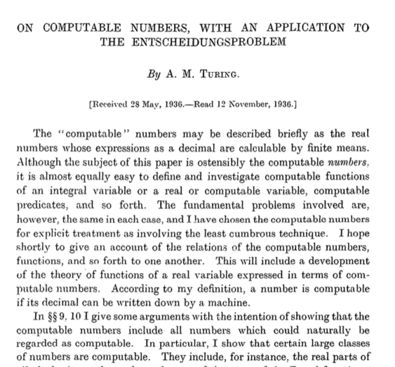
Turing 1936 – Proves that ‘no’ there isn’t such a general method to tell if a FOL formula is valid.

Slide 90
i) Is there a ‘computing machine’ that can decide if some other ‘computing machine’ will stop?
No. The ‘halting problem’ is ‘undecidable’.
ii) Turing goes on to prove that there is no solution to the Decision Problem.

Slide 91
Invert string of binary digits
. . . | | | | | | | |1|0|1| | | | | | | . .
^
(1,0,1,R,1)
(1,1,0,R,1)
(current state, symbol read, symbol written, move, next state)

Slide 92
Invert string of binary digits
. . . | | | | | | | |1|0|1| | | | | | | . .
^
(1,0,1,R,1)
(1,1,0,R,1)

Slide 93
Invert string of binary digits
. . . | | | | | | | |0|0|1| | | | | | | . .
^
(1,0,1,R,1)
(1,1,0,R,1)

Slide 94
Invert string of binary digits
. . . | | | | | | | |0|0|1| | | | | | | . .
^
(1,0,1,R,1)
(1,1,0,R,1)

Slide 95
Invert string of binary digits
. . . | | | | | | | |0|0|1| | | | | | | . .
^
(1,0,1,R,1)
(1,1,0,R,1)

Slide 96
Invert string of binary digits
. . . | | | | | | | |0|0|1| | | | | | | . .
^
(1,0,1,R,1)
(1,1,0,R,1)

Slide 97
Invert string of binary digits
. . . | | | | | | | |0|1|1| | | | | | | . .
^
(1,0,1,R,1)
(1,1,0,R,1)

Slide 98
Invert string of binary digits
. . . | | | | | | | |0|1|1| | | | | | | . .
^
(1,0,1,R,1)
(1,1,0,R,1)

Slide 99
Invert string of binary digits
. . . | | | | | | | |0|1|1| | | | | | | . .
^
(1,0,1,R,1)
(1,1,0,R,1)

Slide 100
Invert string of binary digits
. . . | | | | | | | |0|1|1| | | | | | | . .
^
(1,0,1,R,1)
(1,1,0,R,1)

Slide 101
Invert string of binary digits
. . . | | | | | | | |0|1|0| | | | | | | . .
^
(1,0,1,R,1)
(1,1,0,R,1)

Slide 102
Invert string of binary digits
. . . | | | | | | | |0|1|0| | | | | | | . .
^
(1,0,1,R,1)
(1,1,0,R,1)

Slide 103
Universal Turing Machine (idealized)
|1|0|1|1|1| |1|1|0|1|1| | | | | | | | |0|1|0| |
^
(1,0,1,R,1)
(1,1,0,R,1)

Slide 104
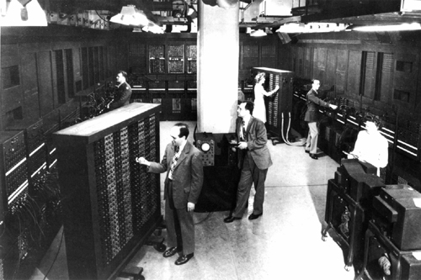

Slide 105
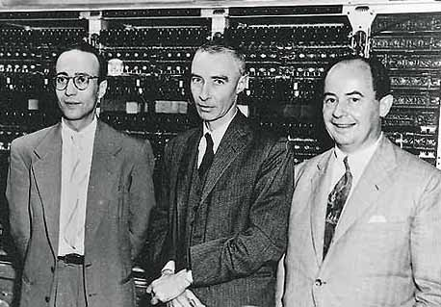

Slide 106
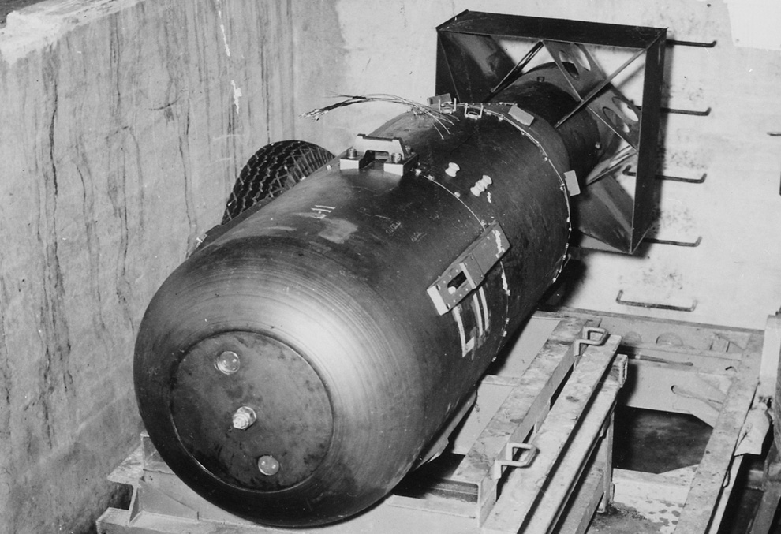

Slide 107
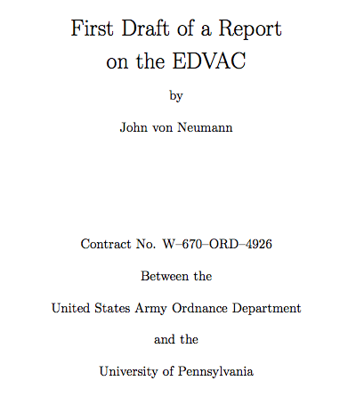
Von Neumann – Unfinished report of the design of the EDVAC

Slide 108
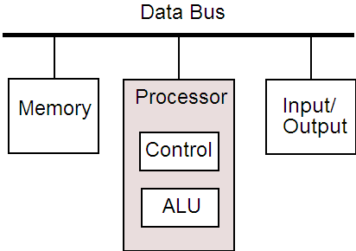
Immortalized as ‘Von Neumann’ architecture

Slide 109
1942 – Mauchly writes ENIAC proposal (decimal)
April 1943 – Army contract for ENIAC
June 1945 (?) – Contract for EDVAC
June 30, 1945 – ‘First Draft’
Feb 14, 1946 – ENIAC announced to public
Feb 19, 1946 – Turing’s ACE Report presented to NPL
July-Aug 1946 – Moore School lectures
Dec 22, 1947 – Eckert & Mauchly form EMCC
June 21, 1948 – Manchester ‘Baby’
Feb 7, 1949 - BINAC
May 6, 1949 – EDSAC
Sept 9, 1951 – LEO ‘Bakery Valuations’ for Lyons food chain

Slide 110
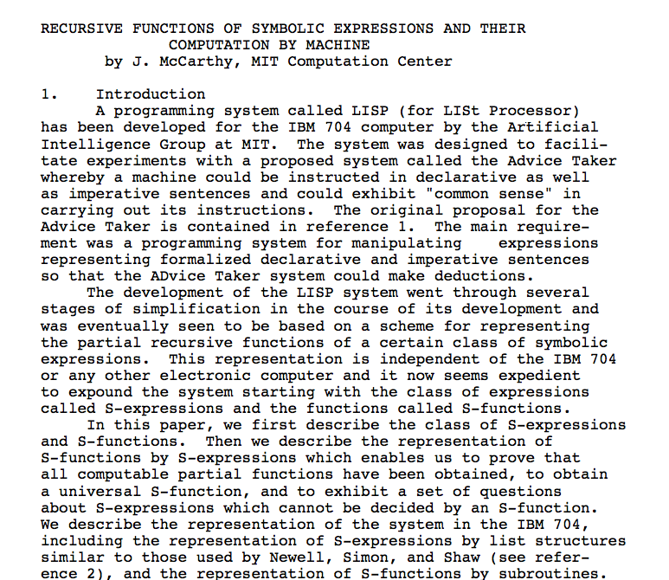
Notes:
.

Slide 111
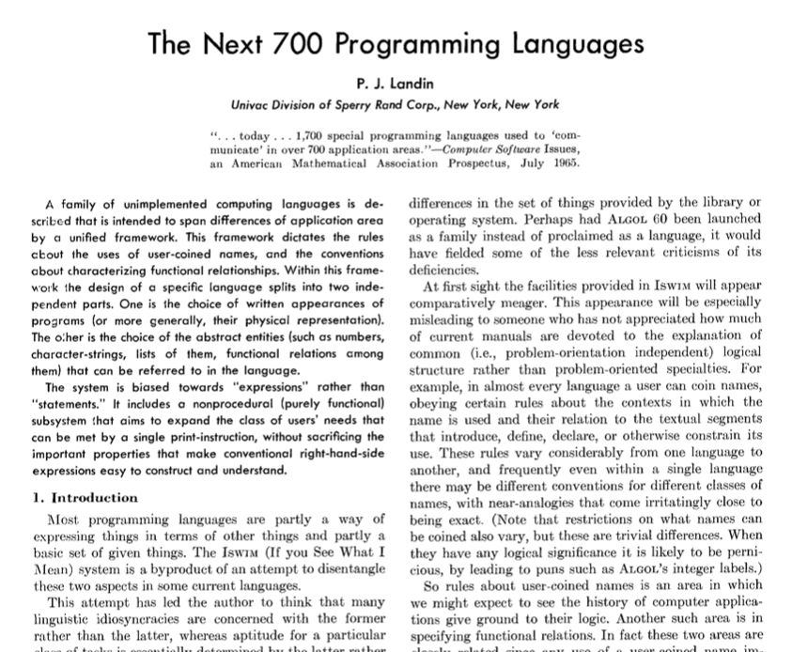

Slide 112
ISWIM (1966)
SASL (1972)
ML (1973)
Scheme (1975)
KRC (1981)
Miranda (1985)
Erlang (1986)
Haskell (1990)
F# (2002)
Scala (2003)
Clojure (2007)

Slide 113
